Slide 1
Capstone 1
SpringBoard First Project

Slide 2
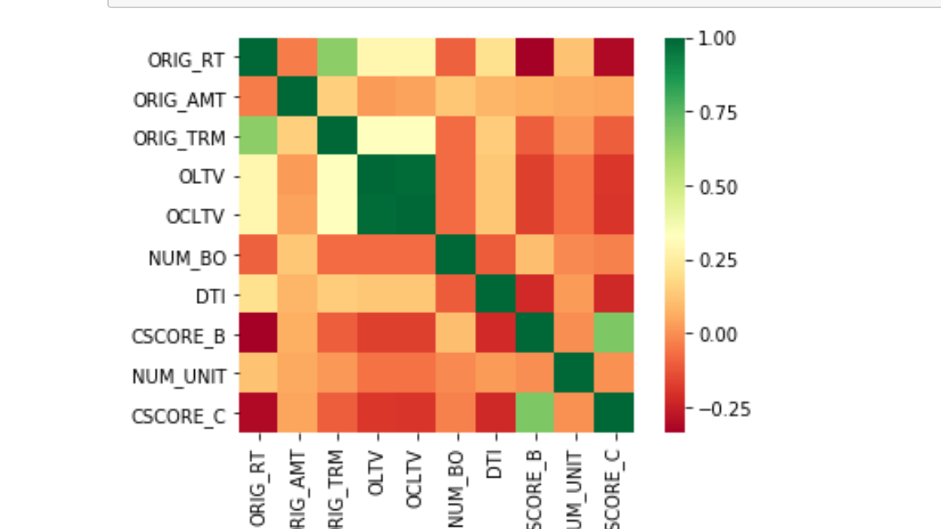
Correlation matrix Heat map

Slide 3
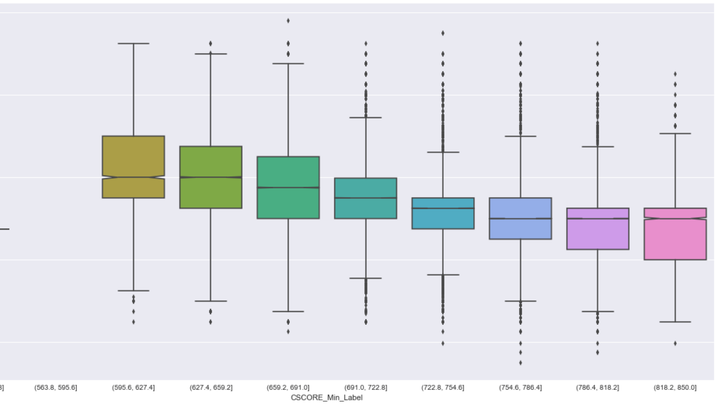
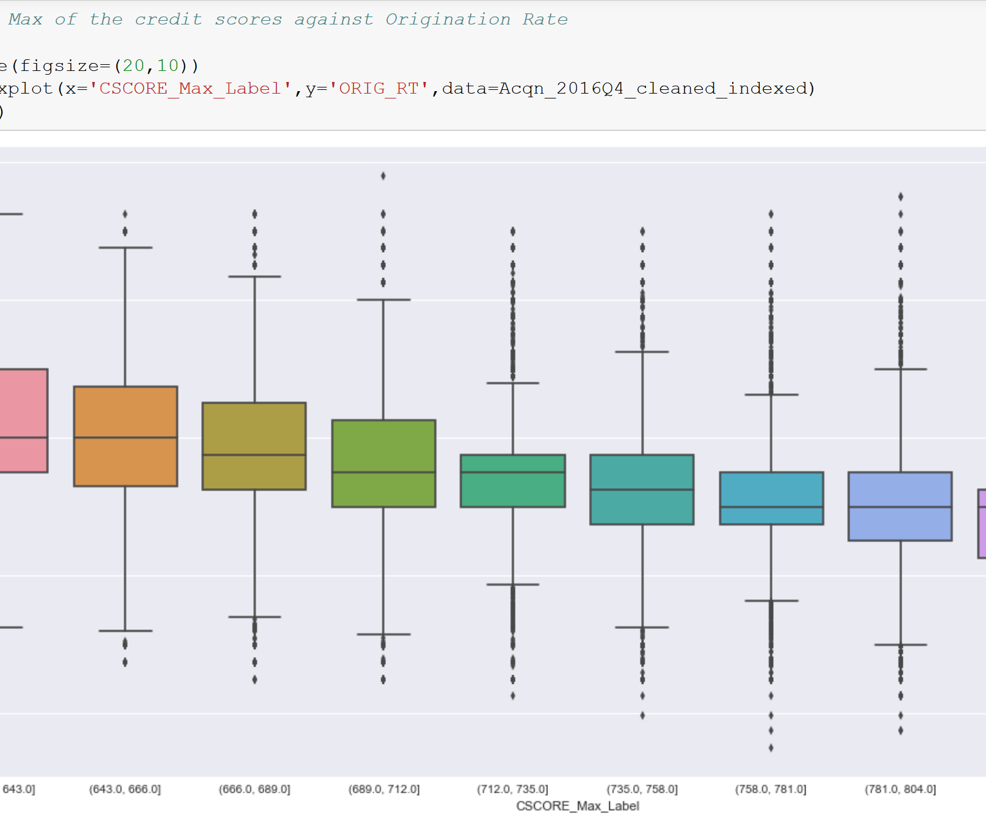
Credit scores and Interest Rates trend
As the graph indicate, as the scores increases rates tend to decrease.

Slide 4
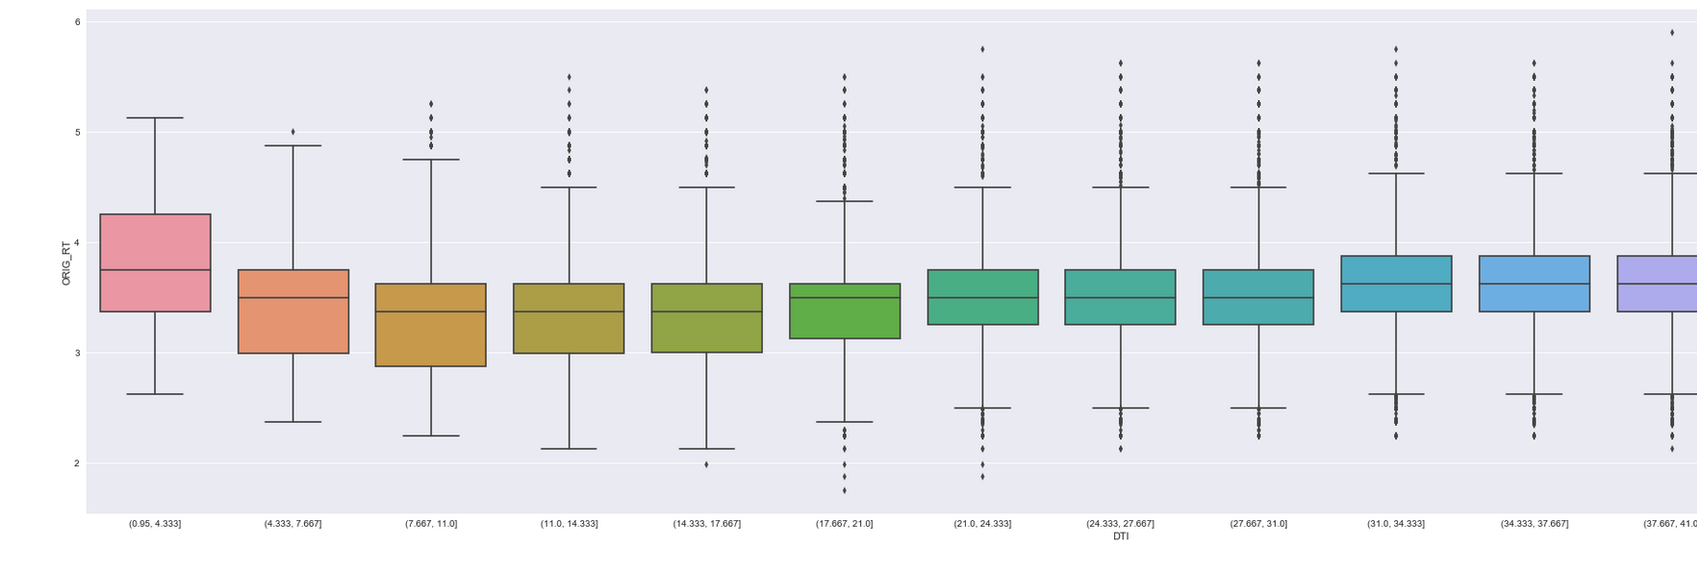
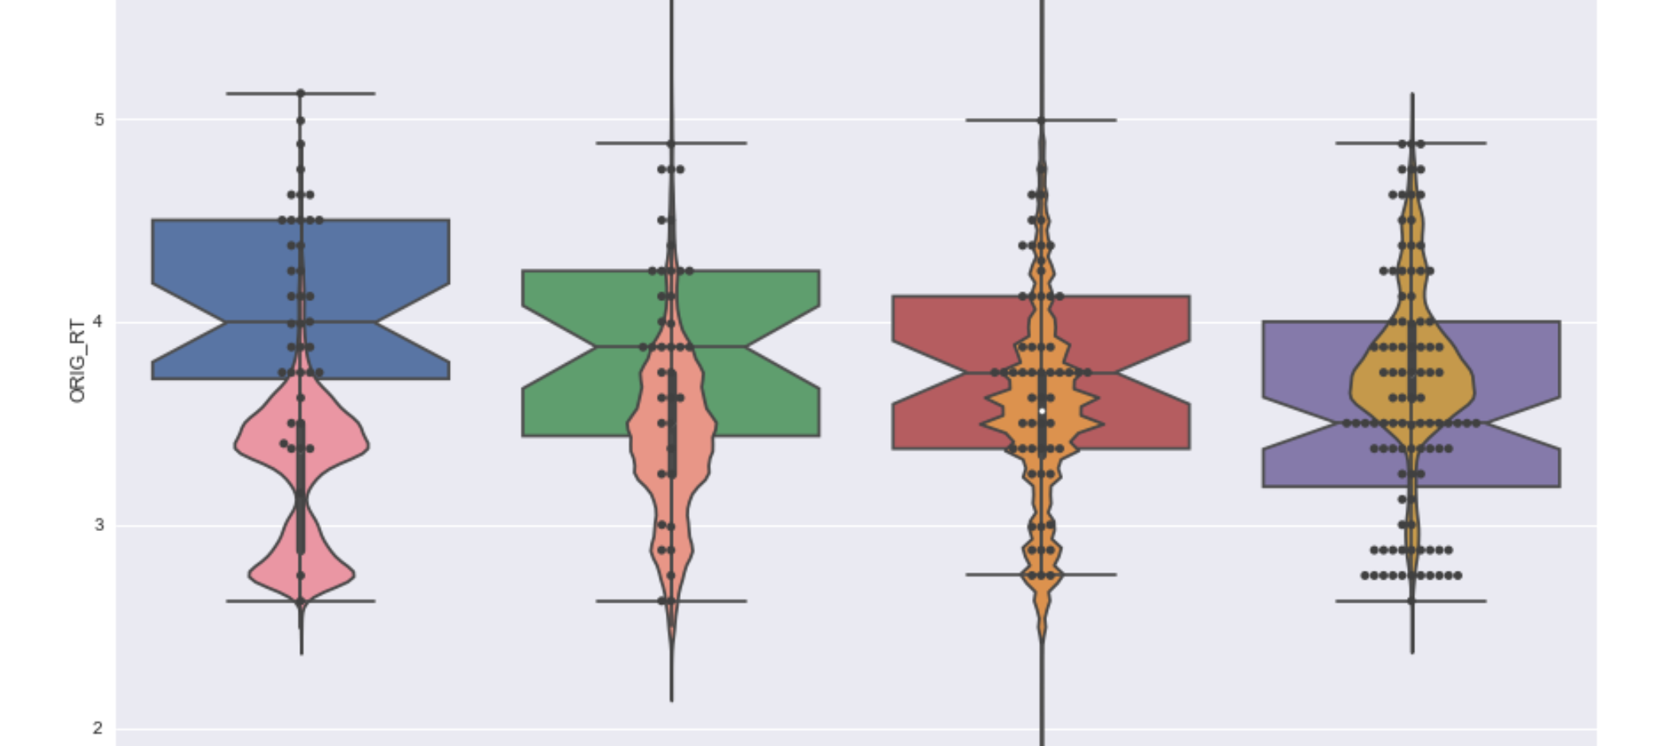
DTI(Debt to Income Ratio) Vs Origination Rates
As the graph indicate, as the DTI increases rates tend to iecrease.

Slide 5
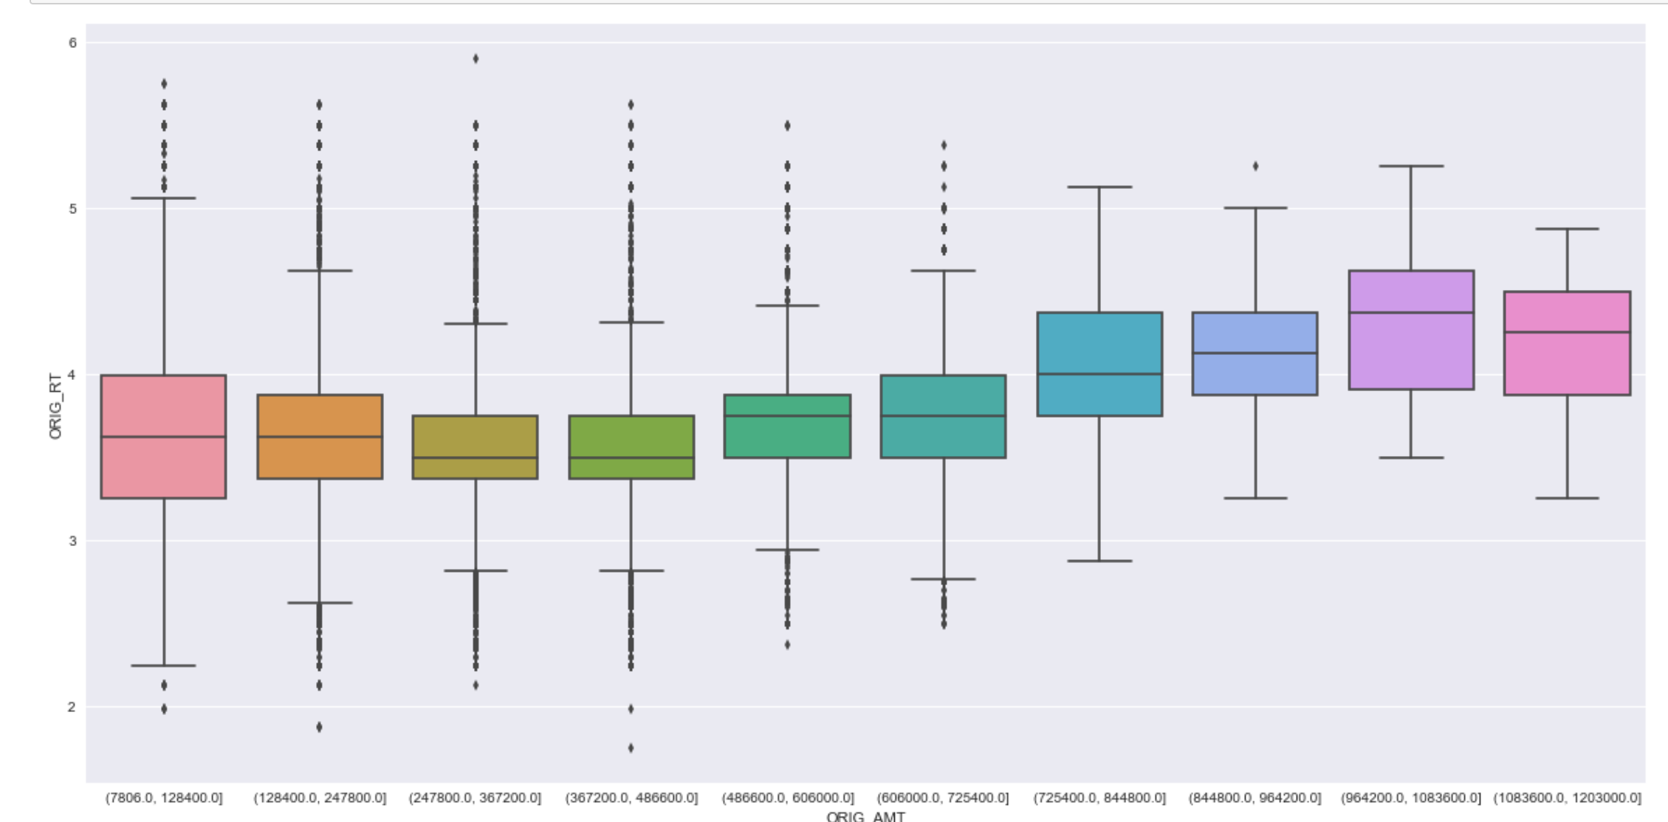
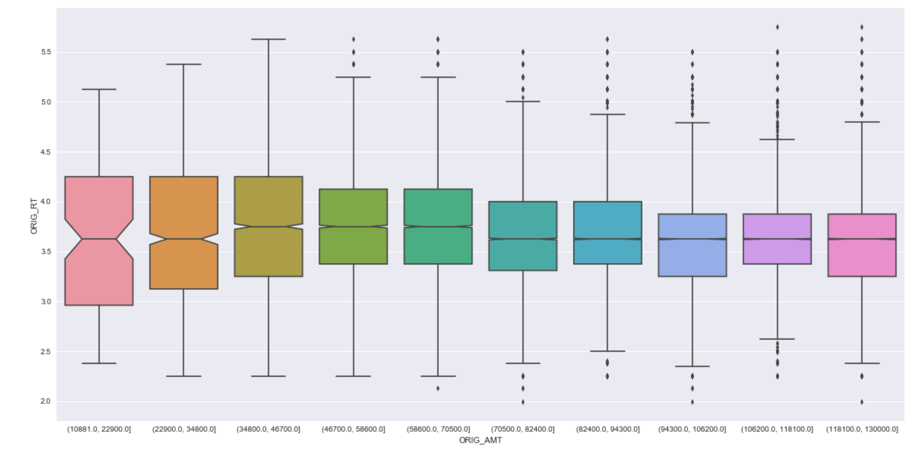
Origination Amounts Vs Origination Rates
As the graph indicate, as the origination amount increases , rates tend to decrease.

Slide 6
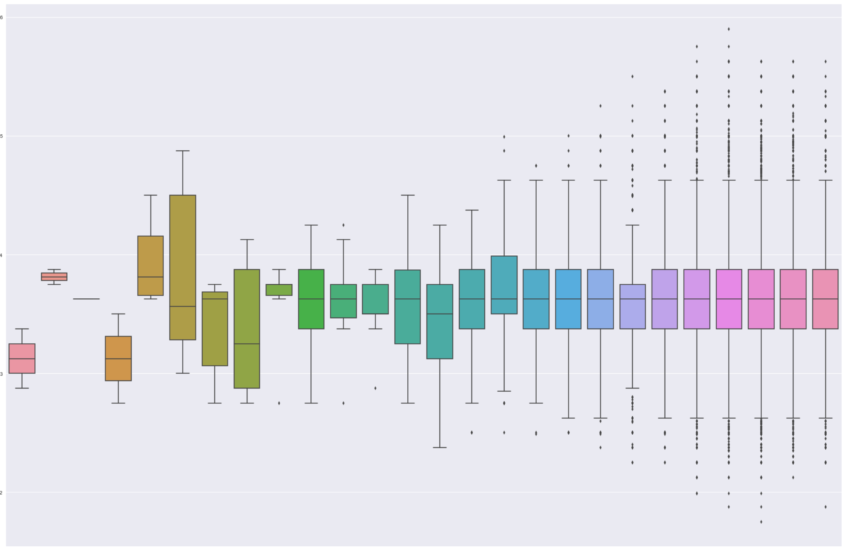
Orig Month Vs Orig Rate
Origination month does not typically have an impact on the rates. But it does indicate if the house was sold in good selling season vs low selling season. Low selling season is typically cold winter times when people don’t sell their homes.

Slide 7
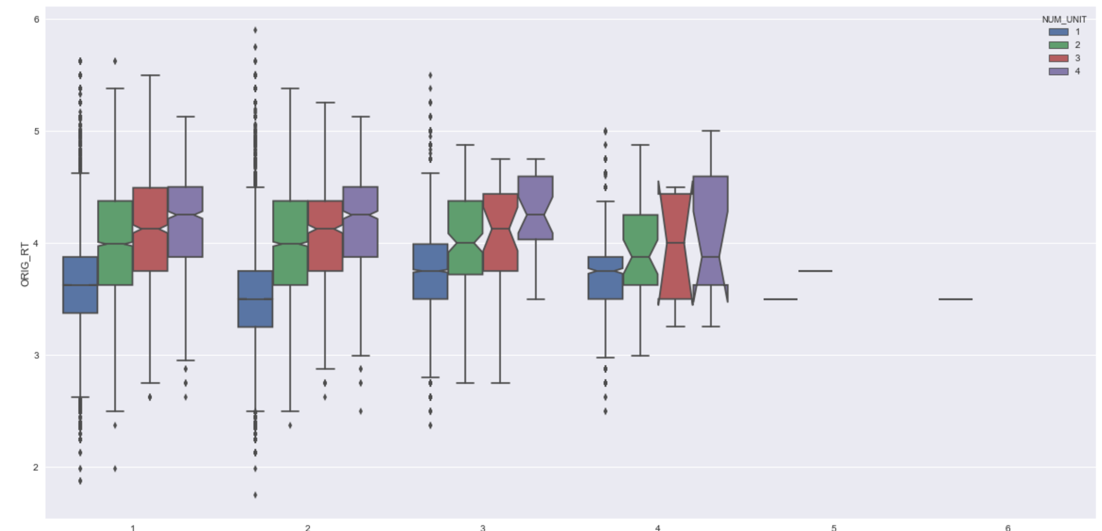
Num of Borrowers Vs Orig Rt
As the graph indicate, as the number of borrowers increase rates tend to increase as well.

Slide 8
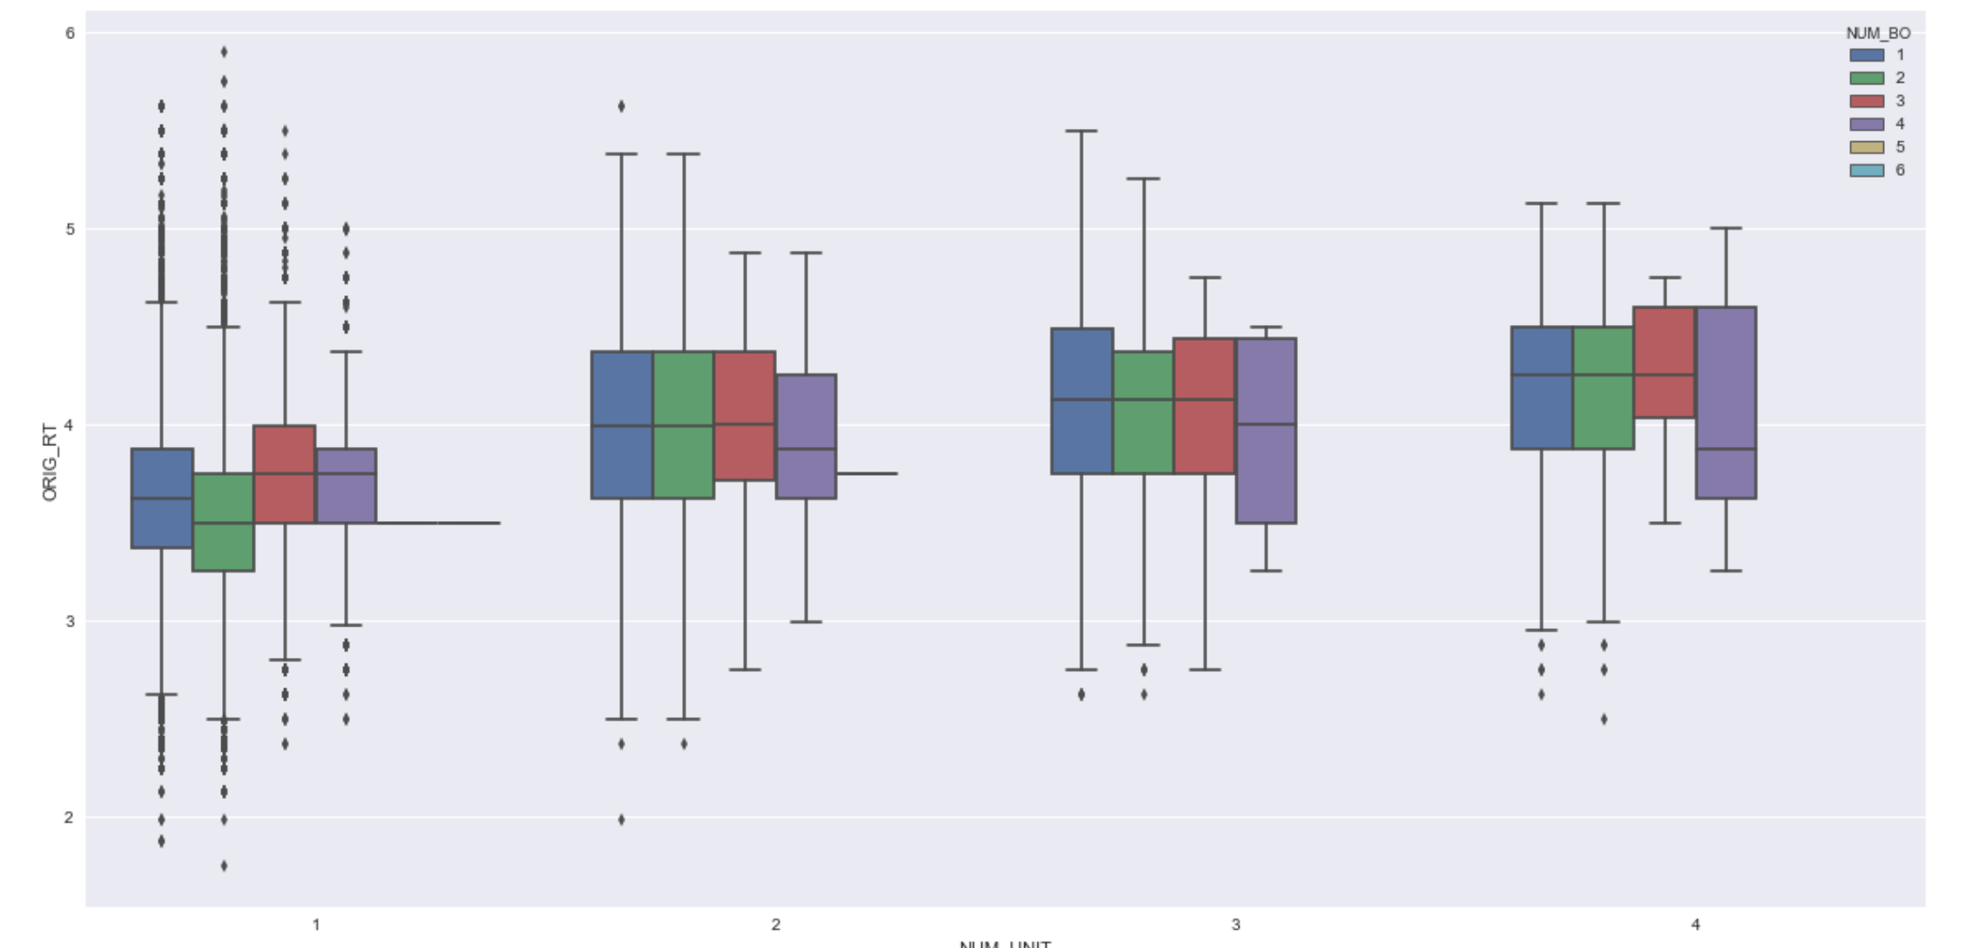
Num of Units Vs Orig Rt
As the graph indicate, as the number of units increase, rates tend to increase as well.

Slide 9
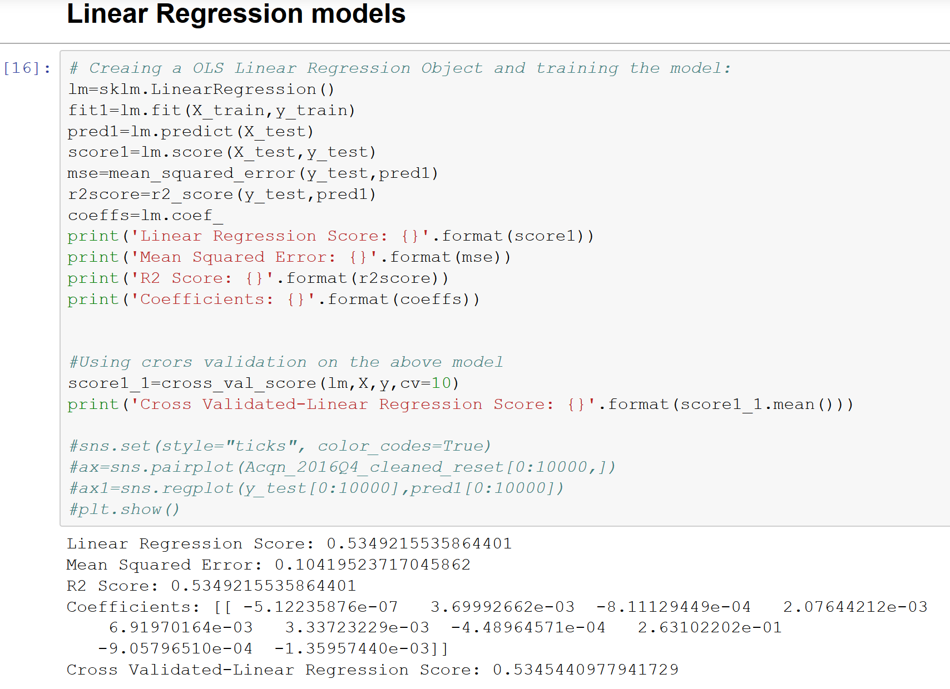
Linear Regression Models
OLS Regression Model gave a success ratio of 53%

Slide 10
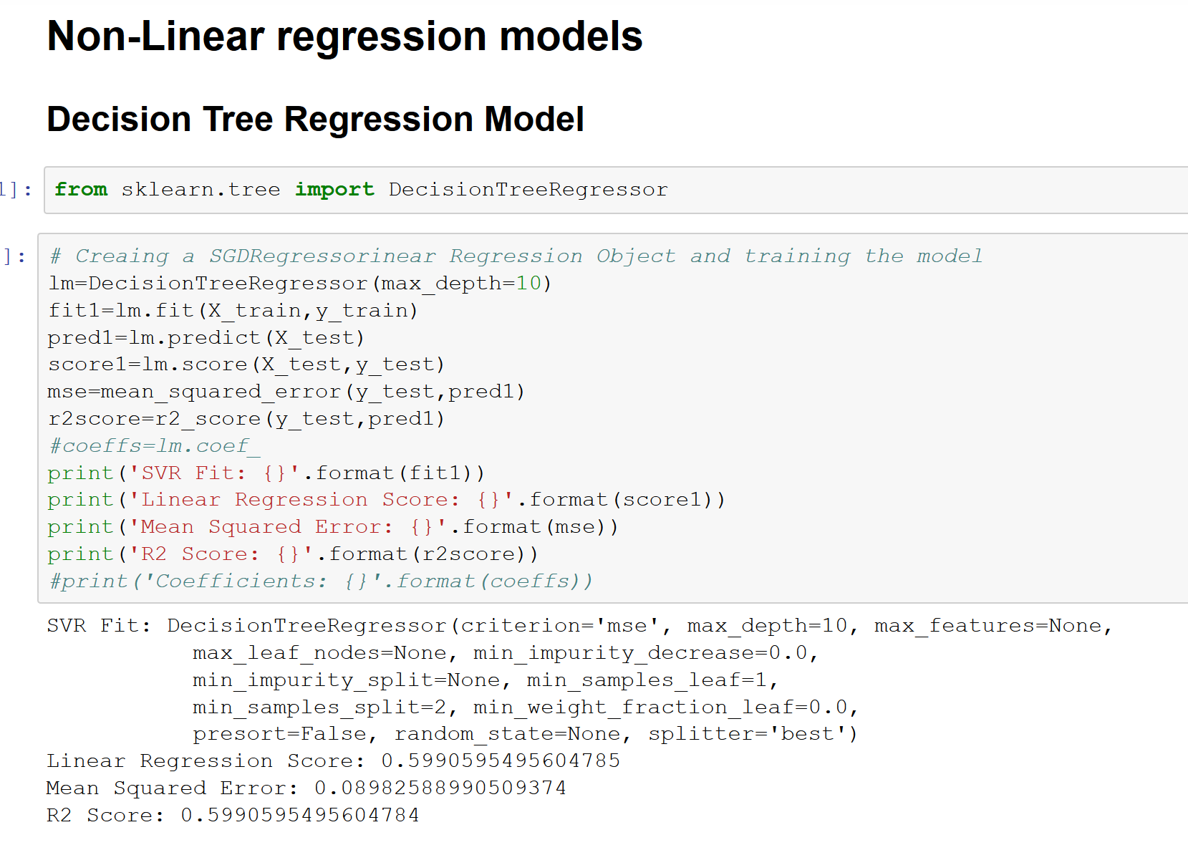
Non Linear Regression Models
Decision Tree Regression Model gave a predtiction accuracy of 59% which is much better than the OLS model.

Slide 11
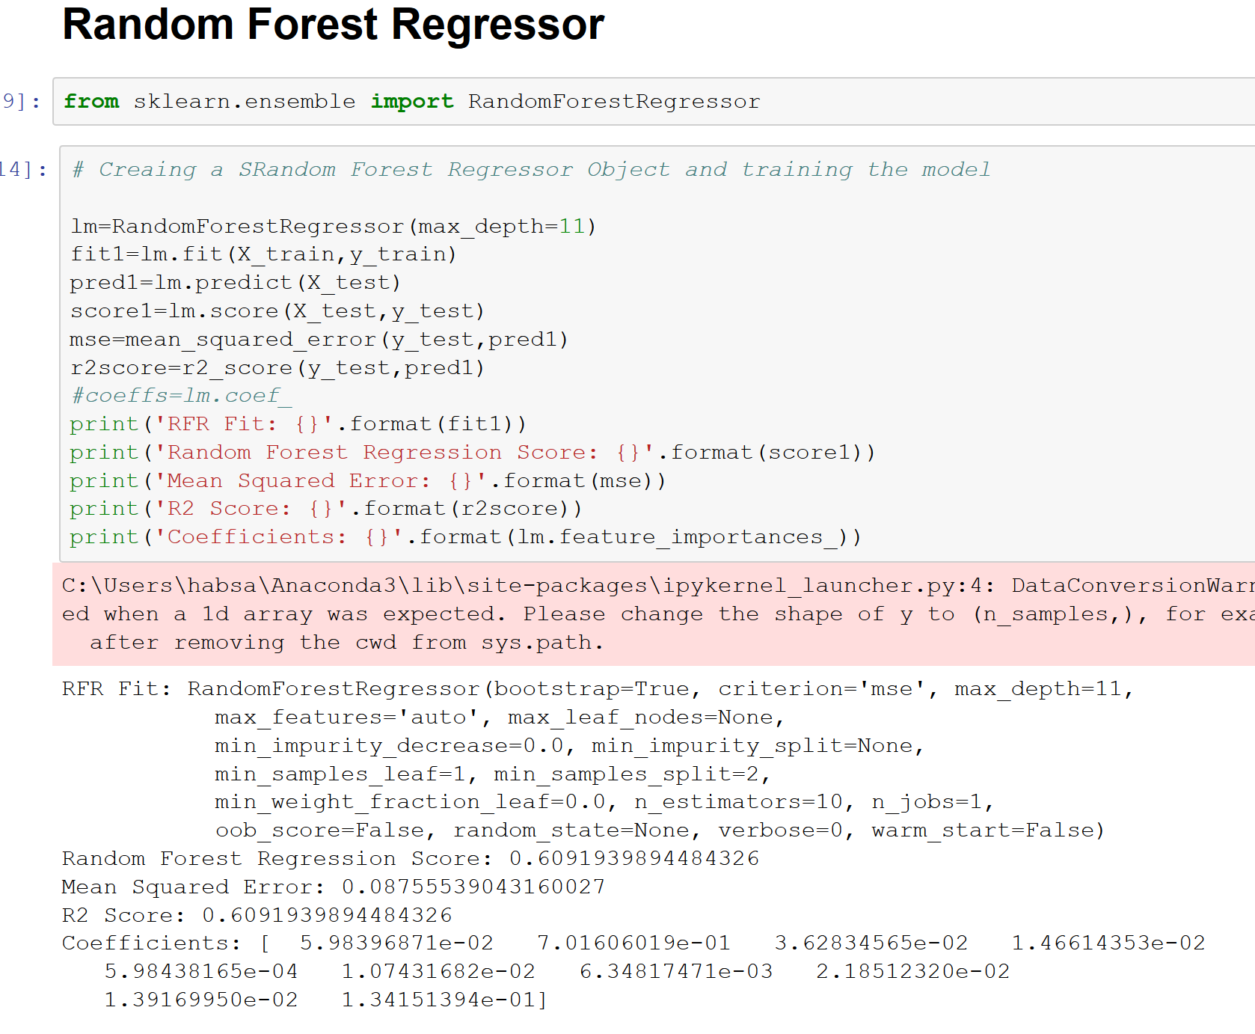
Non Linear Regression Models
Random Forest Regressor improved the prediction capacity to 60%

Slide 12
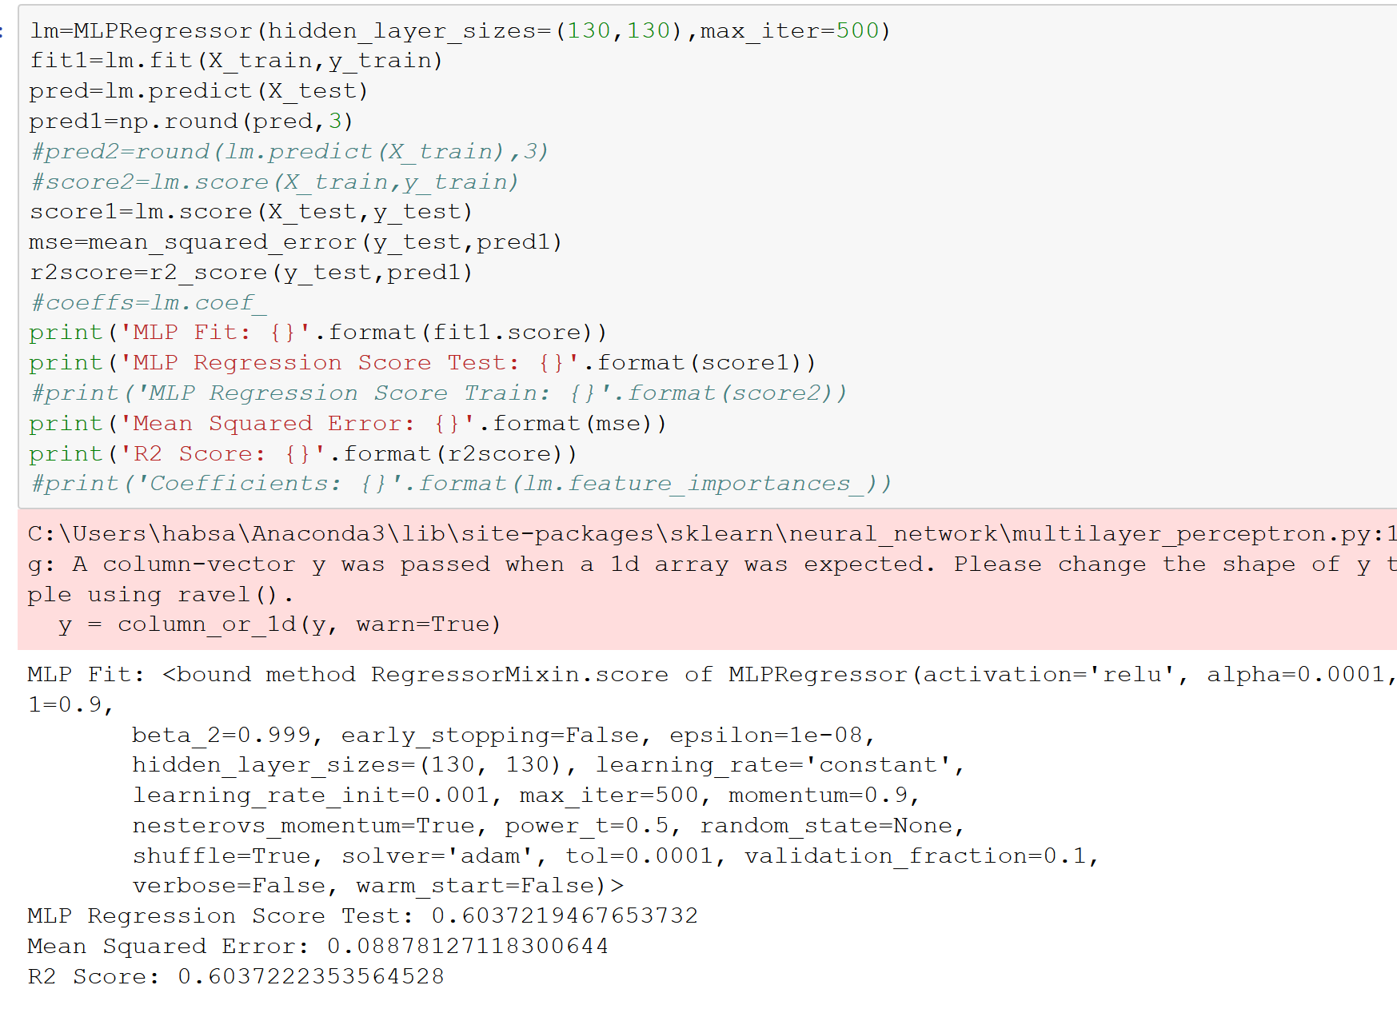
Non Linear Regression Models
Nueral Networks Regression Model (MLP Regressor) improved the prediction capacity to 60%

